Slide 1

CSE 423
Virtualization and Cloud Computing
Lecture 16
Module V
Dr. Madhavi Dhingra

Slide 2
Contents
Cloud Security Fundamentals
Cloud Risk, Cloud Risk Division, Policy and
Organizational Risks, Technical Risks, Legal Risks, Other Risks,
Cloud Computing Security Architecture
VM Security Challenges

Slide 3
Cloud Security
Cloud computing security or cloud security is an important concern which refers to the act of protecting cloud environments, data, information and applications against unauthorized access, DDOS attacks, malwares, hackers and other similar attacks.
When we are thinking about cloud security it includes various types of security like access control for authorized access, network segmentation for maintaining isolated data, encryption for encoded data transfer, vulnerability check for patching vulnerable areas, security monitoring for keeping eye on various security attacks and disaster recovery for backup and recovery during data loss.

Slide 4
Cloud Security
Cloud security has a lot of benefits –
Centralized security : Centralized security results in centralizing protection. As managing all the devices and endpoints is not an easy task cloud security helps in doing so. This results in enhancing traffic analysis and web filtering which means less policy and software updates.
Reduced costs : Investing in cloud computing and cloud security results in less expenditure in hardware and also less manpower in administration
Reduced Administration : It makes it easier to administer the organization and does not have manual security configuration and constant security updates.
Reliability : These are very reliable and the cloud can be accessed from anywhere with any device with proper authorization.

Slide 5
Security Issues in Cloud
1. Data Loss –
Data Loss is one of the issues faced in Cloud Computing. This is also known as Data Leakage. As we know that our sensitive data is in the hands of Somebody else, and we don’t have full control over our database. So, if the security of cloud service is to break by hackers then it may be possible that hackers will get access to our sensitive data or personal files.
2. Interference of Hackers and Insecure API’s –
As we know, if we are talking about the cloud and its services it means we are talking about the Internet. Also, we know that the easiest way to communicate with Cloud is using API. So it is important to protect the Interface’s and API’s which are used by an external user. But also in cloud computing, few services are available in the public domain which are the vulnerable part of Cloud Computing because it may be possible that these services are accessed by some third parties. So, it may be possible that with the help of these services hackers can easily hack or harm our data.

Slide 6
Cloud Security Issues
3. User Account Hijacking –
Account Hijacking is the most serious security issue in Cloud Computing. If somehow the Account of User or an Organization is hijacked by a hacker then the hacker has full authority to perform Unauthorized Activities.
4. Changing Service Provider –
Vendor lock-In is also an important Security issue in Cloud Computing. Many organizations will face different problems while shifting from one vendor to another. For example, An Organization wants to shift from AWS Cloud to Google Cloud Services then they face various problems like shifting of all data, also both cloud services have different techniques and functions, so they also face problems regarding that. Also, it may be possible that the charges of AWS are different from Google Cloud, etc.

Slide 7
Cloud Security Issues
5. Lack of Skill –
While working, shifting to another service provider, need an extra feature, how to use a feature, etc. are the main problems caused in IT Company who doesn’t have skilled Employees. So it requires a skilled person to work with Cloud Computing.
6. Denial of Service (DoS) attack –
This type of attack occurs when the system receives too much traffic. Mostly DoS attacks occur in large organizations such as the banking sector, government sector, etc. When a DoS attack occurs, data is lost. So, in order to recover data, it requires a great amount of money as well as time to handle it.

Slide 8
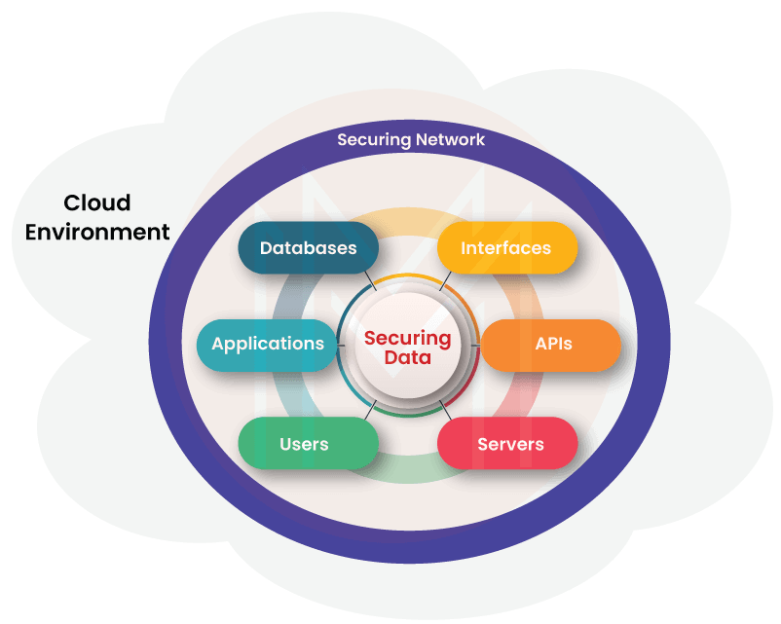
Cloud Security Architecture
Essentially, the cloud security architecture is the security strategy that aims at protecting applications, data, and systems in a cloud environment. In other words, the cloud security architecture is a model that defines various crucial components in the cloud environment and monitors them closely to secure its resources.
The components include the security layers, identity management, infrastructure, access control, best practices, protection mechanisms, policies for security compliance, threat management, security compliance standards, etc.
The significant thing about cloud security architecture is that it works based on shared responsibility. It is nothing but the responsibility shared between customers and cloud providers.

Slide 9
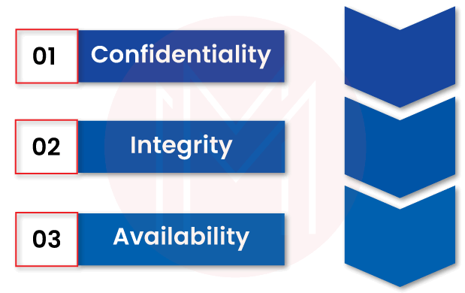
Core Capabilities of CSA
1. Confidentiality
This is one of the capabilities of the cloud security architecture, which focuses on trust and privacy. Essentially, confidentiality is the ability of security policies and methods to protect cloud data and applications. This architecture ensures that no one can access cloud resources without permission.
2. Integrity
It ensures applications and other resources in the cloud environment are working as per users’ expectations – from the security point of view.
3. Availability
This is yet another capability of the cloud security architecture that ensures the availability of data and other resources in the cloud environment to access by users at any time. For example, a cloud environment must be free from DoS attacks anytime. If not, you cannot run your business normally.

Slide 10
Few Threats or Challenges in CS
1. Inefficient Security Strategies
When it comes to cloud security, you cannot employ the same security models and strategies you use to secure data centers and on-premises resources. But, you must embrace integrated security systems in clouds to overcome the security breaches that may occur due to advanced and automated attacks.
2. Misconfigurations
Misconfigurations in cloud security will lead to security breaches. It usually occurs because of human errors. Lapses in the security perimeter also induce errors in cloud security.
3. Inconsistency in Security
This problem occurs because of poor visibility across the cloud environment. Not only that, lack of centralized controls and policies may cause inconsistency in the security of cloud resources.

Slide 11
Few Threats or Challenges in CS
4. Insider Threats
These threats occur because of the people who access data internally. It means the people who work in the organization have more chances to access and misuse data easily. Similarly, cloud service provider administrators can misuse the data and other resources [1].
5. DoS Attacks
DoS stands for Denial-of-Service. When a low-scale DoS attack is made against systems and data, users cannot access the services until the attack is resolved. If it is a high-scale attack, no surprise restoration of systems will take days and weeks.
6. Shadow IT
This is yet another severe threat when people manage cloud resources without understanding them completely. For example, developers may connect workloads with their personal accounts. It will definitely open doors to access the cloud resources without authorization.
Apart from all the mentioned threats, there are a few other threats to cloud security, such as malware injection, credential stuffing threats, advanced persistent threats, zero-day attacks, insecure APIs, phishing, and many more.

